Slide 1
Introduction to Auto-Cropped Plate Test Images

Slide 2
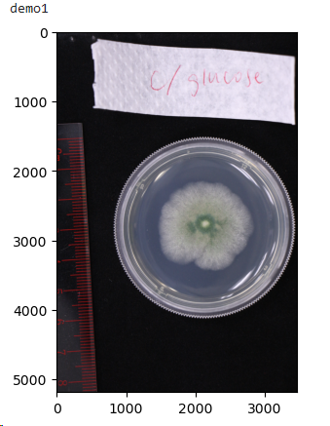
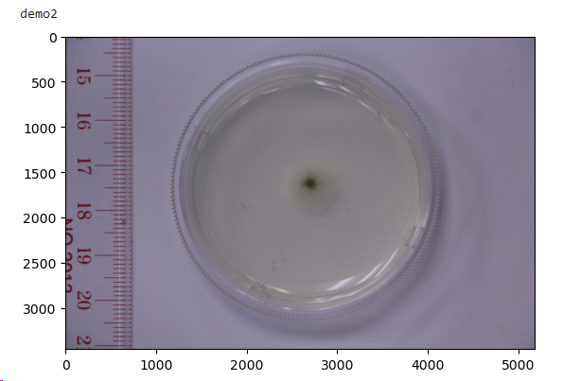
Two demo images were used in this tutorial. Demo1 from Winnie. (IMG_2782.JPG) Demo2 from XiaoYuan. (IMG_2887.JPG)

Slide 3
Working flow
Image1 (input image)
Cut label
image2
Detect edges
Cut top and bottom
Image 3
Detect edges
Cut left and right
Image 4 (output image)
Judge success or not

Slide 4
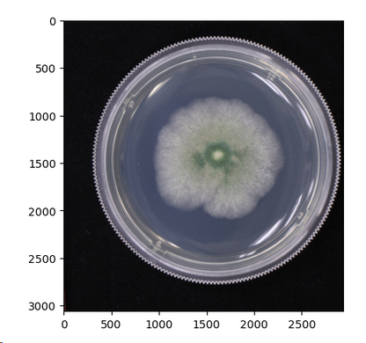
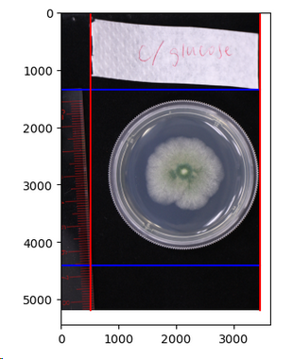
(1) Cut label
In the plate test images, it is common to have rulers or labels present. To ensure accurate detection of the plate's edges, it is advisable to remove these elements beforehand.
In the script, you can achieve this by specifying the percentages (n1, n2, n3, n4) to be cropped from the top, bottom, left, and right sides of the image. These values can be assigned as floating-point numbers to the variables top_cut, bottom_cut, left_cut, and right_cut, respectively.
During this step, the labels are eliminated, and special care is taken to ensure that the plate remains centered within the resulting cropped image (image2).
top_cut = 0.26 bottom_cut = 0.15
(two blue lines)
left_cut = 0.15 right_cut = 0
(two red lines)

Slide 5
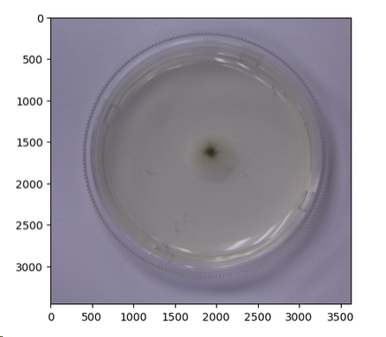
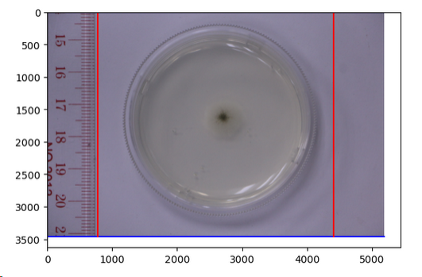
top_cut = 0 bottom_cut = 0
(two blue lines)
left_cut = 0.15 right_cut = 0.15
(two red lines)

Slide 6
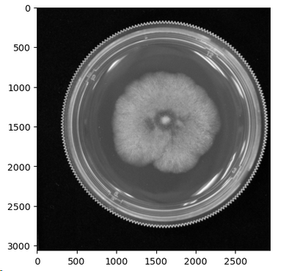
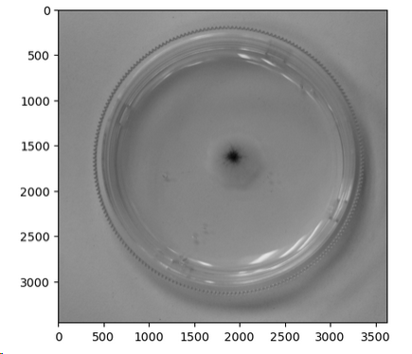
(2) Detect edges of image2
Before edges detection, the script will transfer the image to a gray image and using gaussian blur to reduce noise.
Demo1
Demo2

Slide 7
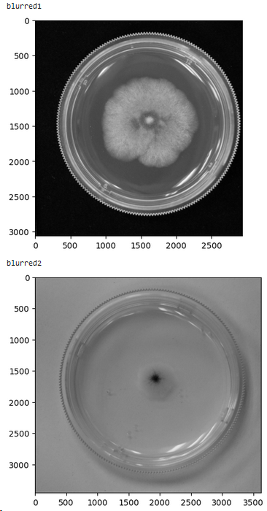
canny_down and canny_up are the most important parameters. You should find a best value for them.
Canny_down: Pixels with gradient values below this threshold are not considered as edges.
Canny_up: Pixels with gradient values above this threshold are considered as strong edges.
The use of varying values can significantly impact the outcome, making it imperative to tailor the parameter selection to different groups.
In demo1, there is a high contrast between the plate edge and the background. To ensure accurate results, it is crucial to set canny_down and canny_up to higher values. Failure to do so may result in the inclusion of excessive noise, which can adversely impact the outcome.
In demo2, the contrast between the plate edge and the background is relatively low. To ensure successful edge detection, it is recommended to set canny_down and canny_up to lower values. Failing to do so may lead to the inability to detect the plate edge accurately.

Slide 8
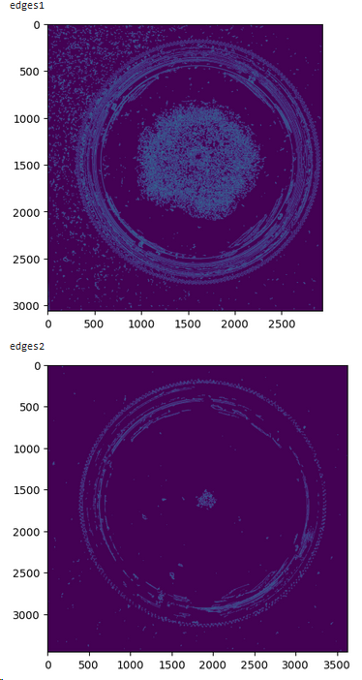
canny_down = 5
canny_up = 30
Image show the pixels which be considered as edges

Slide 9
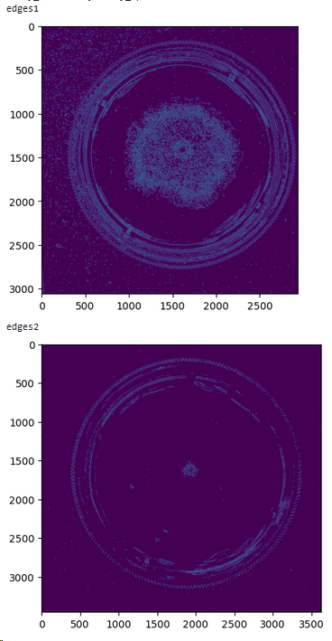
canny_down = 15
canny_up = 30
Image show the pixels which be considered as edges

Slide 10
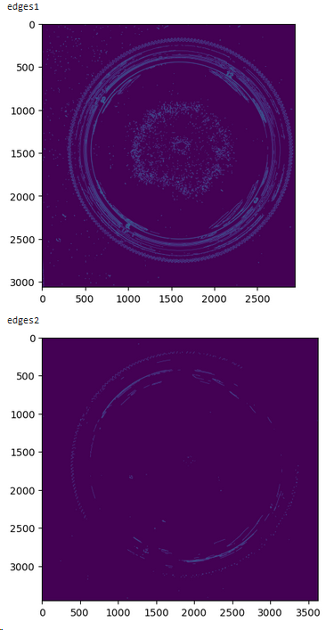
Image show the pixels which be considered as edges
canny_down = 30
canny_up = 50

Slide 11
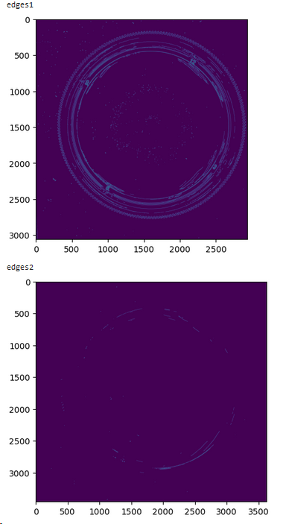
canny_down = 50
canny_up = 70
Image show the pixels which be considered as edges

Slide 12
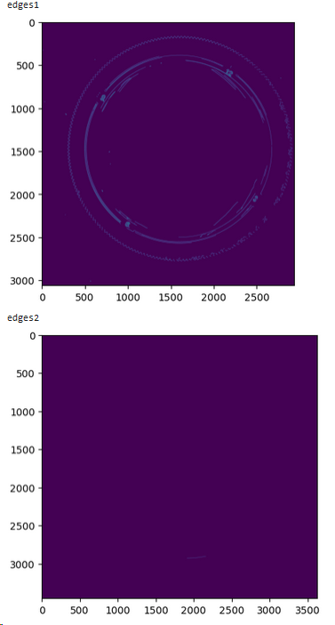
Image show the pixels which be considered as edges
canny_down = 70
canny_up = 200

Slide 13
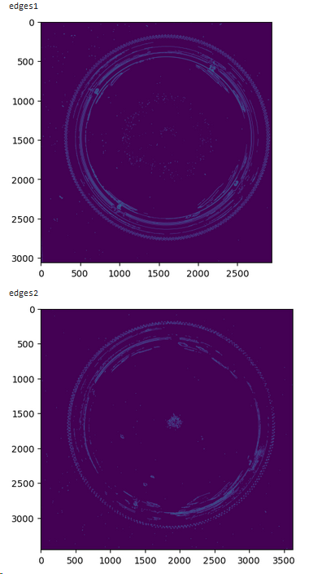
The selection of canny_down and canny_up should show the edges clearly and reduce the impact of noise.
Here I use canny_down=50, canny_up=70 for demo1 and canny_down=15, canny_up=30 for demo2.
canny_down = 50
canny_up = 70
Image show the pixels which be considered as edges
canny_down = 15
canny_up = 30

Slide 14
(3) Cut top and bottom
For each pixel, a value of 1 is assigned if it is identified as an edge, otherwise, it is set to 0. The script then calculates the sum of each row.
If the sum of a row exceeds the noise threshold, it is classified as a plate row. Conversely, rows with sums below the threshold are considered non-plate rows.
Determining the appropriate value for noise threshold is crucial and should be based on the characteristics of the signal in the plate edges and the noise present in the images.
The non-plate rows closest to the center of the image are designated as the top and bottom edges of the plate.

Slide 15
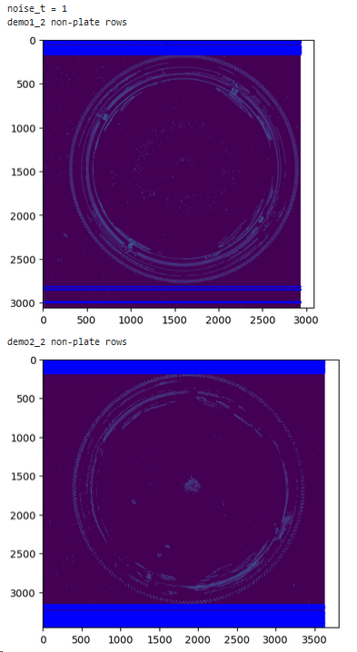
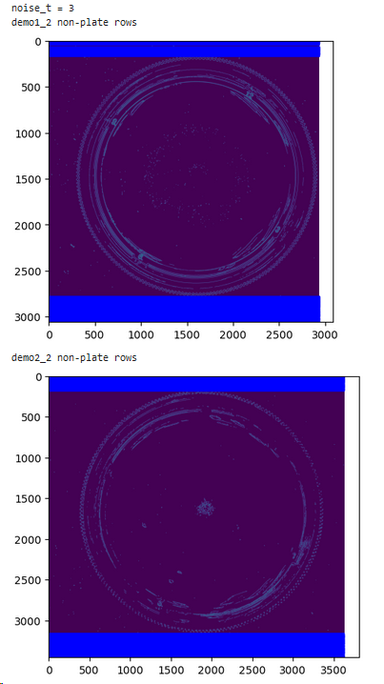
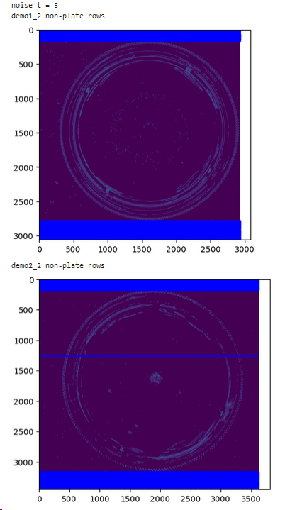

Slide 16
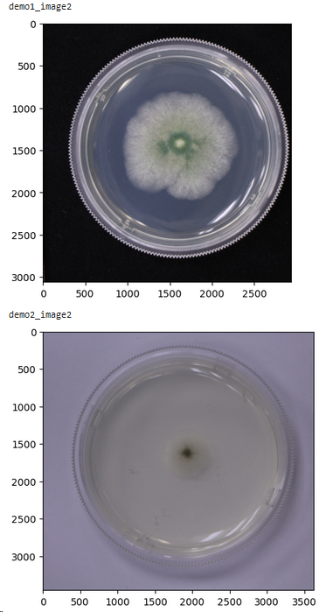
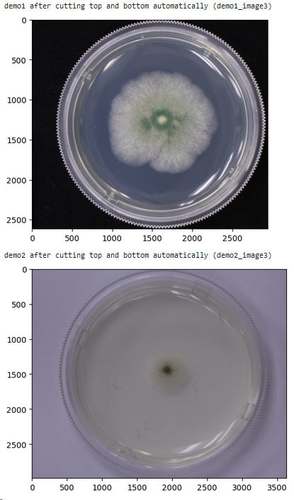
canny_down = 50
canny_up = 70
noise_t =3
canny_down = 15
canny_up = 30
noise_t =3

Slide 17
(4) Detect edges of image3
It’s similar to detect edges of image2
(5) Cut left and right
Calculate the sum of each column.
If the sum of column > noise threshold, the column will be classified as plate column, otherwise, the columns will be classified as non-plate column.

Slide 18
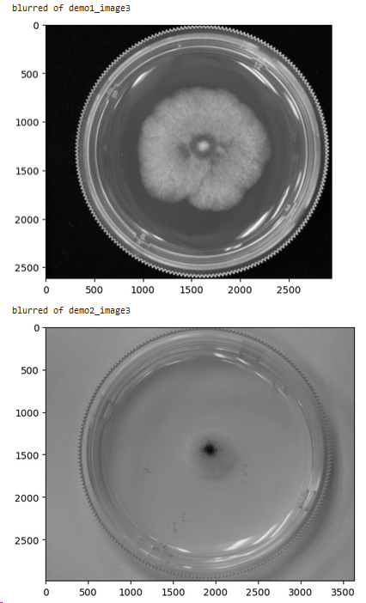
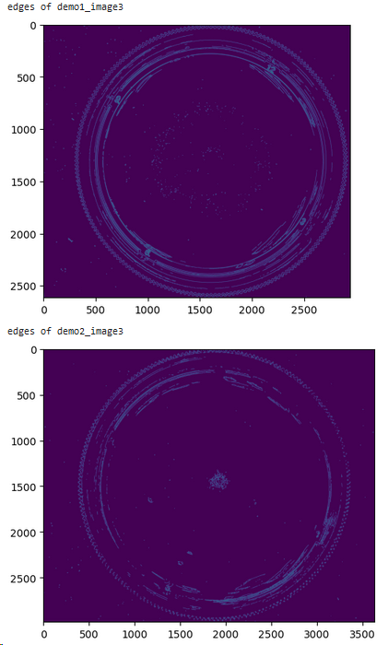

Slide 19
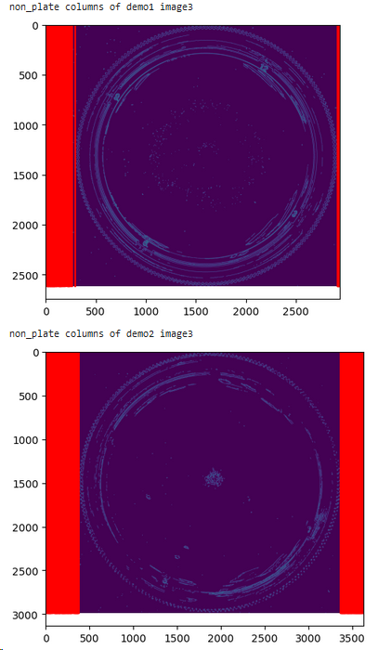
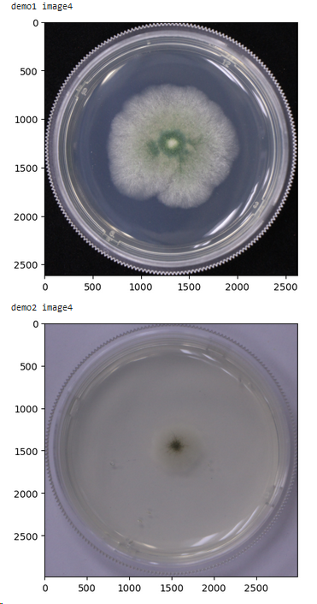

Slide 20
(6) Check if the cropping was successful
Once the final cropped image is obtained, the script proceeds to calculate its aspect ratio. A successful cropping is determined when the aspect ratio exceeds 0.98 (default value).
Please note that while the script considers a cropping successful based on the aspect ratio criterion, it is advisable to manually review and verify the results for accuracy.

Slide 21
Tips:
The positions of the plate and label should be relatively fixed, allowing the values of top_cut, bottom_cut, left_cut, and right_cut to be applicable to all samples in a set of experiments.
The plate is transparent and is photographed against a dark background, which facilitates the detection of its edges. (Sometimes, if the color of the colonies is relatively dark, it may be necessary to capture the image against a light background. In such cases, the effectiveness of the script may be compromised.)

